Slide 1
Community Based Reporting and Monitoring Tool for Women's Safety in Colleges/Universities
PIP4004 University Project
Review-3
Project Statement: PSCS-88
Under the Supervision of,
Dr. Aarif Ahamed
Professor
School of Computer Science and Engineering
Presidency University
Roll Number | Student Name
20211CSE0810 | BALAGUNDLA SATISH
20211CSE0807 | G V NANDINI
20211CSE0764 | DHARE CHETHAN
Name of the Program: B.Tech Computer Science and Engineering
Name of the HoD: Dr. Asif Mohammed
Name of the Program Project Coordinator: Prof. Srinivas Mishra
Name of the School Project Coordinators: Dr. Sampath A K / Dr. Abdul Khadar A / Mr. Md Ziaur Rahman

Slide 2
Content
Problem Statement
Abstract
Objectives
Literature Review
Existing Methods-Drawbacks
Proposed Method
Architecture Diagram
Hardware and Software Details
Time Line by Gantt Chart
References

Slide 3
Problem Statement Number: PSCS_88
Problem Creator’s Organization: Jharkhand
Category (Hardware / Software / Both) : Software
Problem Description: Campuses of colleges and universities are meant to be vibrant, free-flowing, and dynamic in nature. An accommodating campus supports idea exchange, personal growth, and soft skill development. The safety of students, especially women's students, is a pillar of an accommodating campus. In the present scenario, the measures available to college administrators and students, such as the installation of CCTV cameras, increased security on campuses, and the establishment of police outposts, are reactive in nature, i.e., they are pressed into action only after the occurrence of a mishap. The objective of the problem statement is to develop predictive analytic models to prevent mishaps even before they occur. The second issue pertaining to women's safety is the lack of manpower for proactive interventions to prevent mishaps. Another objective is to develop, monitor, predict, and provide actionable intelligence for the prevention of mishaps. The solution can explore the contours of anonymous and non-anonymous data collection mechanisms, point-to-point reporting systems, and predictive data analytics for providing actionable intelligence. Further, the collected data can be leveraged to develop and mark probable black spots and red time zones for pin-pointed actions to be taken by administrators. To promote a community-based system, the system may be designed in such a way that it not only gathers information from students but also involves the entire student community in the prevention of mishaps. The data collected from the participants can be populated into the system, and real-time monitoring can be done with an interactive dashboard and charts. It can also be used to develop real-time rapid intervention by the student community, college administration, and local authorities. Further to this, a companion model can also be developed for students that helps them travel through black spots and during red time zones.

Slide 4
Problem Statement Number: PSCS_88
Technology Budget: Miscellaneous
Difficulty Level: Simple

Slide 5
Abstract
Ensuring the safety of women in colleges and universities is a critical concern that requires innovative solutions. This project proposes the development of a Community-Based Reporting and Monitoring Tool for Women's Safety. The tool aims to empower students, particularly women, by providing a secure and efficient platform for reporting incidents of harassment, violence, or any unsafe situations.
The tool features anonymous reporting, real-time alerts, and GPS tracking to ensure prompt responses from campus authorities. By integrating data visualization, the platform enables administrators to monitor safety trends and take proactive measures. The collaborative nature of the tool fosters a supportive environment, encouraging students, faculty, and campus security to work together in creating a safer campus.
Developed using Java and Android Studio, the tool is designed to be user-friendly and accessible. Initial testing and feedback from pilot deployments in select colleges will guide further refinements. Ultimately, this project aims to enhance women's safety on campuses, ensuring a secure and inclusive educational environment.

Slide 6
Objectives
Empower Women for Anonymous Reporting
Real-Time Incident Monitoring
Data-Driven insights for safety improvements
Community Engagement
Improve Awareness and Prevention
Integration with campus Security system

Slide 7
Literature Review
Women's safety in educational institutions is a critical concern, and the integration of technology with community-driven approaches has emerged as a promising solution. This literature review explores existing research on community-based reporting and monitoring tools for women's safety, focusing on IoT, mobile applications, and community involvement in college/university settings.
1. IoT-Based Safety Systems
IoT (Internet of Things) has been widely adopted in safety systems due to its ability to provide real-time monitoring and alerts. Research by Nandinee et al. (2020) proposes a wearable IoT device integrated with a mobile app for women's safety. The system includes GPS tracking, an SOS button, and real-time alerts to emergency contacts. Similarly, Kumar et al. (2021) present an IoT-based smart campus safety system that integrates wearable devices, surveillance cameras, and mobile apps for real-time monitoring. These studies highlight the effectiveness of IoT in creating a robust safety infrastructure.
2. Mobile Applications for Safety
Mobile applications have become a popular tool for women's safety due to their accessibility and ease of use. Patel et al. (2020) discuss a mobile app that allows users to send emergency alerts with their location to predefined contacts and authorities. Aher et al. (2019) propose a similar system using GPS and GSM technologies. These apps emphasize the importance of real-time location sharing and quick access to emergency services, which are critical for women's safety in colleges and universities.
3. Community-Driven Reporting Systems
Community involvement is a key aspect of enhancing women's safety. Gupta et al. (2022) propose a mobile crowdsourcing platform where community members can report safety concerns and incidents in real-time. This approach leverages the collective effort of the community to identify and address safety issues. Similarly, Singh et al. (2021) explore the concept of community-driven safety networks, where users can report incidents and share safety tips. These studies demonstrate the potential of community-based reporting systems in creating safer environments.

Slide 8
Literature Review
4. Campus-Specific Safety Solutions
Several studies focus on safety solutions tailored for educational institutions. Das et al. (2023) propose IoT-enabled devices specifically designed for women's safety in colleges, including panic buttons and real-time tracking. Kodali et al. (2021) provide a comprehensive survey of IoT-based systems for women's safety, highlighting their applications in campus environments. These studies emphasize the need for customized solutions that address the unique challenges of college and university settings.
Mobile Applications: Mobile apps are a convenient tool for reporting incidents and sharing location data.
Community Involvement: Community-driven reporting systems leverage collective effort to enhance safety.
Advanced Technologies: Blockchain and machine learning add security and intelligence to safety systems.
Campus-Specific Solutions: Customized solutions are needed to address the unique challenges of educational institutions.
Conclusion:
The integration of IoT, mobile applications, and community-driven approaches offers a promising solution for enhancing women's safety in colleges and universities. Future research should focus on developing and evaluating comprehensive systems that address the unique challenges of educational institutions while ensuring data privacy and user adoption.

Slide 9
Existing Methods - Drawbacks
Internal Complaints Committees (ICC):
Description: Many institutions have established ICCs to address complaints of sexual harassment and violence.
Drawbacks: Often, these committees lack transparency and can be biased. Victims may feel intimidated or fear retaliation, leading to underreporting.
Safety Apps:
Description: Various mobile apps allow students to send distress signals and share their location with campus security.
Drawbacks: These apps require active use, which may not be feasible in all situations. Additionally, they often lack integration with campus security systems.
Awareness and Sensitization Programs:
Description: Programs aimed at educating students and staff about gender sensitivity and harassment.
Drawbacks: While beneficial, these programs alone are insufficient. They need to be part of a broader, systemic approach to be effective.
Physical Security Measures:
Description: Measures such as increased lighting, security patrols, and surveillance cameras.
Drawbacks: These measures can be costly and may not cover all areas. They also do not address the root causes of harassment and violence.

Slide 10
Existing Methods - Drawbacks
Women's Colleges:
Description: Some women opt for single-sex colleges, believing they are safer.
Drawbacks: While these colleges may feel safer, they can limit social opportunities and diversity. Additionally, they do not eliminate the risk of harassment entirely.

Slide 11
Proposed Methods
Real-Time Alerts
GPS Tracking
Data Visualization
Community Engagement
User-Friendly Interface
Awareness Campaigns

Slide 12
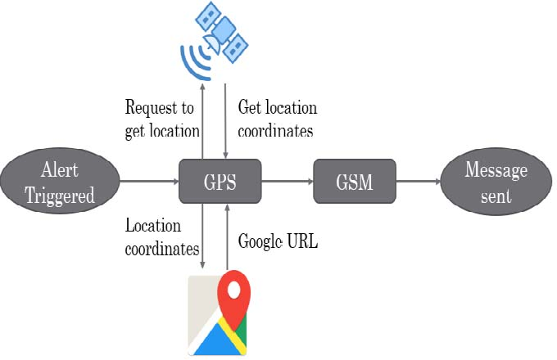
Architecture Diagram

Slide 13
Hardware and Software Details
Hardware details:
Microcontroller
GPS module
GSM module
Emergency button
Bluetooth module
Battery
Buzzer
Audio recording module
Software details:
Mobile Application
Backend server

Slide 14
Github Link
project-gv nandini G-74/PSCS_88

Slide 15
Project Timeline
S.NO | Review | Dates
1 | Review-0 | 29-Jan-2025 To 31-Jan-2025
2 | Review-1 | 18-Feb-2025 To 21-Feb-2025
3 | Review-2 | 17-Mar-2025 To 21-Mar-2025
4 | Review-3 | 21-Apr-2025 To 26-Apr-2025
5 | Final Viva | 10-5-2025 TO 17-5-2025

Slide 16
References
https://www.irjet.net/archives/V11/i3/IRJET-V11I313.pdf
https://ijrpr.com/uploads/V5ISSUE5/IJRPR27732.pdf
https://www.youtube.com/watch?v=iqx-2t7Mrqg
https://doi.org/10.55248/gengpi.5.0524.1248

Slide 17


